Slide 1
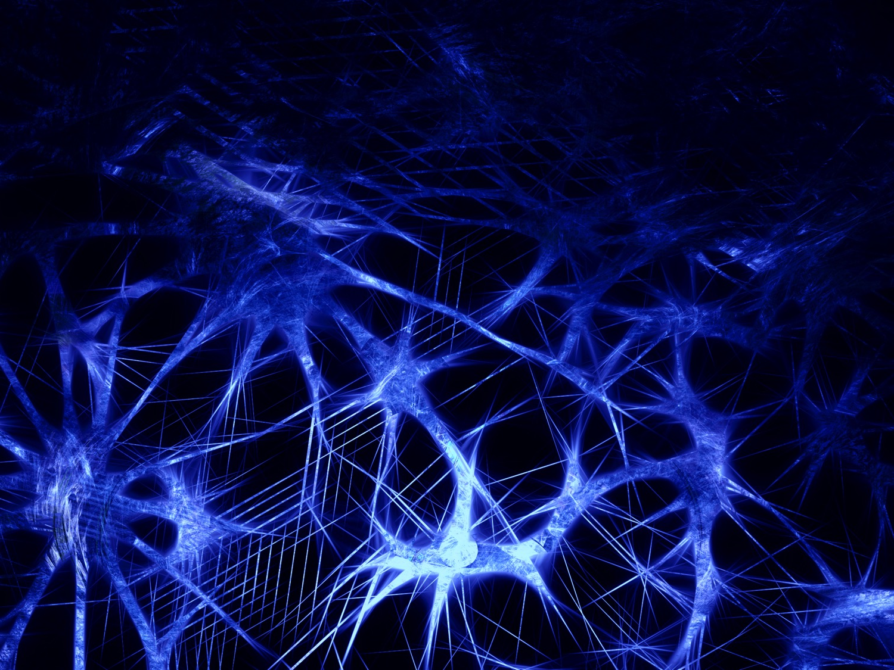
Deep Learning Neural Networks What they are, what they can do, and what they cannot do
James V Stone, University of Sheffield
Notes:
Title: Nature’s Neural Currency: Energy or Information?
The currency of neurons
Is Information the Language of Neurons?
Neural Information Theory:
Is Neural Coding Efficient?
Efficiency and Neural Information Theory
The Efficient Coding Hypothesis Predicts Inefficient Neurons
SAY: Nothing in biology makes sense except in the light of evolution.
ASK: What is the main driver? Information per Joule?
KIT = mex hat, wine glass,
Main point: key properties efficient coding hypothesis.
In any system there is one main driver (Taylor expansion).
Barlow (1961)
Not just how, but why. Indeed not even how, but why.
Plan: do colour in detail and skim rest.
Main point: key properties are consistent with efficient coding hypothesis.
Keep it simple.
\begin{enumerate}
\item colour after effects - castle AE.
\item spatial receptive field of ganglion cell - wear mexican hat.
\item temporal receptive field of neuron - ping a glass.
\item log-normal distribution of fibre diameters.
\item GC-LGN synaptic conductance optimised for efficiency Harris 2015.
\end{enumerate}
==

Slide 2
Structure
What is a deep learning neural network?
What can neural networks do?
History of AI
Before Artificial Neural Networks (1700-1940)
Key Neural Network Developments (1940-present)
What can neural networks NOT do?
Conclusion
Notes:
To understand a system need to begin by examining mechanisms, but also need to consider task being executed by those mechanisms.
Spatial receptive field of ganglion cell - wear mexican hat.
Temporal receptive field of neuron - ping a glass.
Log-normal distribution of fibre diameters.
GC-LGN synaptic conductance optimised for efficiency Harris 2015.

Slide 3
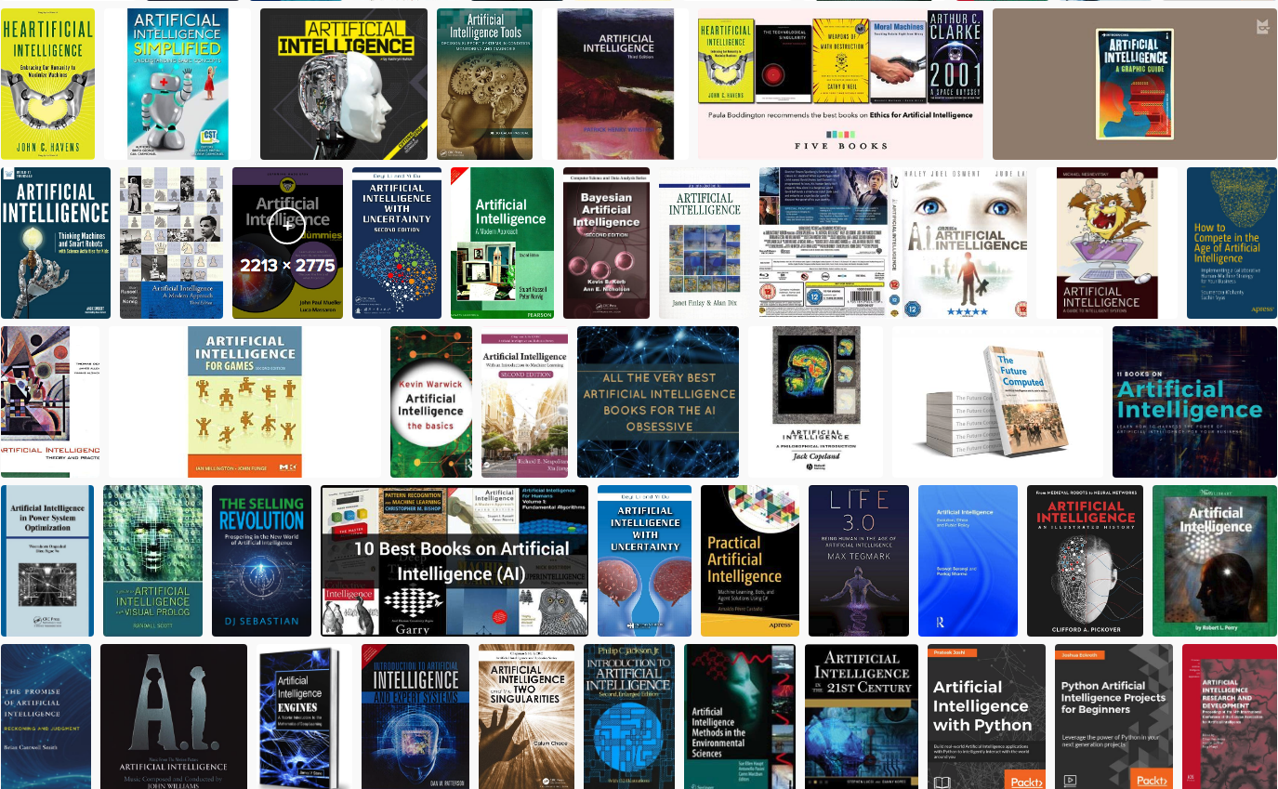
Artificial Intelligence Books

Slide 4
What is a deep learning neural network?

Slide 5
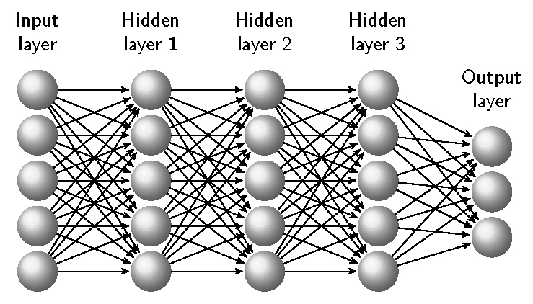
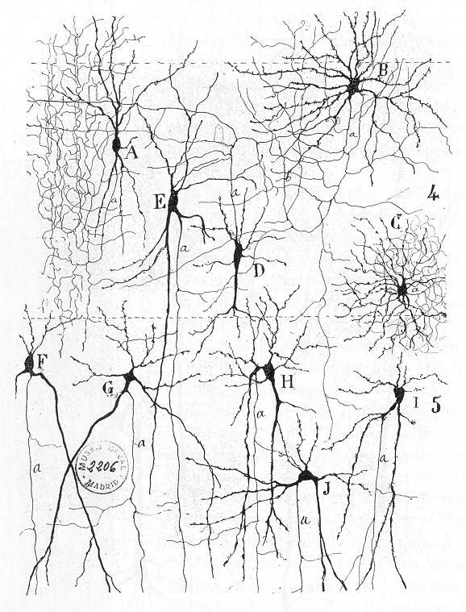
What is a deep learning neural network?
Deep learning network
Cajal’s drawing of neurons, 1900
unit
weight
Notes:
Santiago Ramón y Cajal (Spanish: [sanˈtjaɣo raˈmon i kaˈxal]; 1 May 1852 – 17 October 1934) was a Spanish neuroscientist

Slide 6
Three similarities to human memory
1) Content Addressable. Neural network memories are content addressable, so recall is triggered by an image or a sound. In contrast, a computer memory can be accessed only if the specific location (address) of the required information is known.
2) Generalisation. Neural networks can generalise. Recall can be triggered by an input image that is merely similar to a learned association.
3) Graceful Degradation. If a single weight or unit is destroyed, this does not remove a particular learned association; instead, it degrades all associations to some extent.

Slide 7
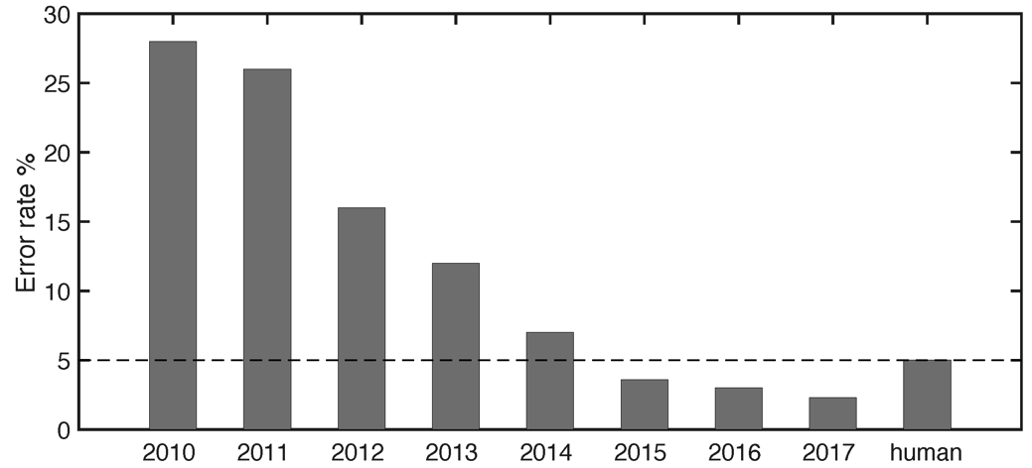
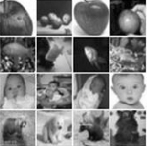
What can deep neural networks do? Classifying Images
The latest competition involves classifying about 1.5 million images into 1,000 object classes.
The percentage error on the annual Large Scale Visual Recognition Challenge (ILSVRC) image classification competition has fallen dramatically since 2010.
Reproduced with permission from Wu and Gu (2015).

Slide 8
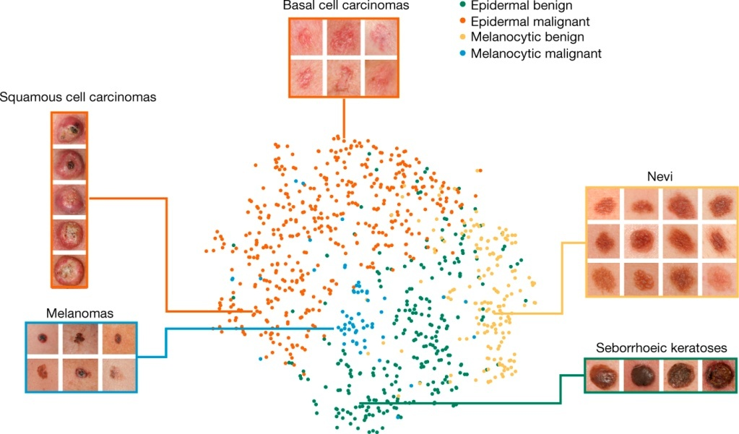
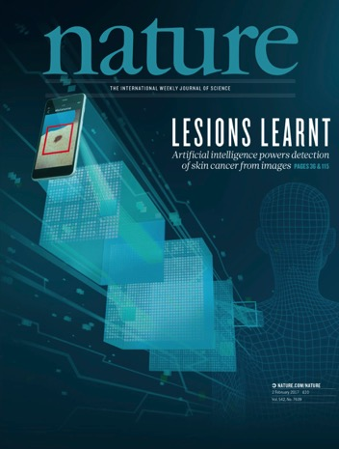
What can deep neural networks do? Medical diagnosis
The Convolutional Neural Ntwork’s representation of four important disease classes of melanoma (skin cancer). 2017
Notes:
Performance is “on a par with” consultants performance.
Plus: Deep learning can predict microsatellite instability directly from histology in gastrointestinal cancer.
Nature Brief Communication, June 2019
In this work, we pretrain a deep neural network at general object recognition, then fine-tune it on a dataset of ~130,000 skin lesion images comprised of over 2000 diseases.
Here we show the CNN’s internal representation of four important disease classes by applying t-SNE, a method for visualizing high-dimensional data, to the last hidden layer representation in the CNN of the biopsy-proven photographic test sets (932 images). Coloured point clouds represent the different disease categories, showing how the algorithm clusters the diseases. Insets show images corresponding to various points. Images reprinted with permission from the Edinburgh Dermofit Library (https://licensing.eri.ed.ac.uk/i/software/dermofit-image-library.html).

Slide 9
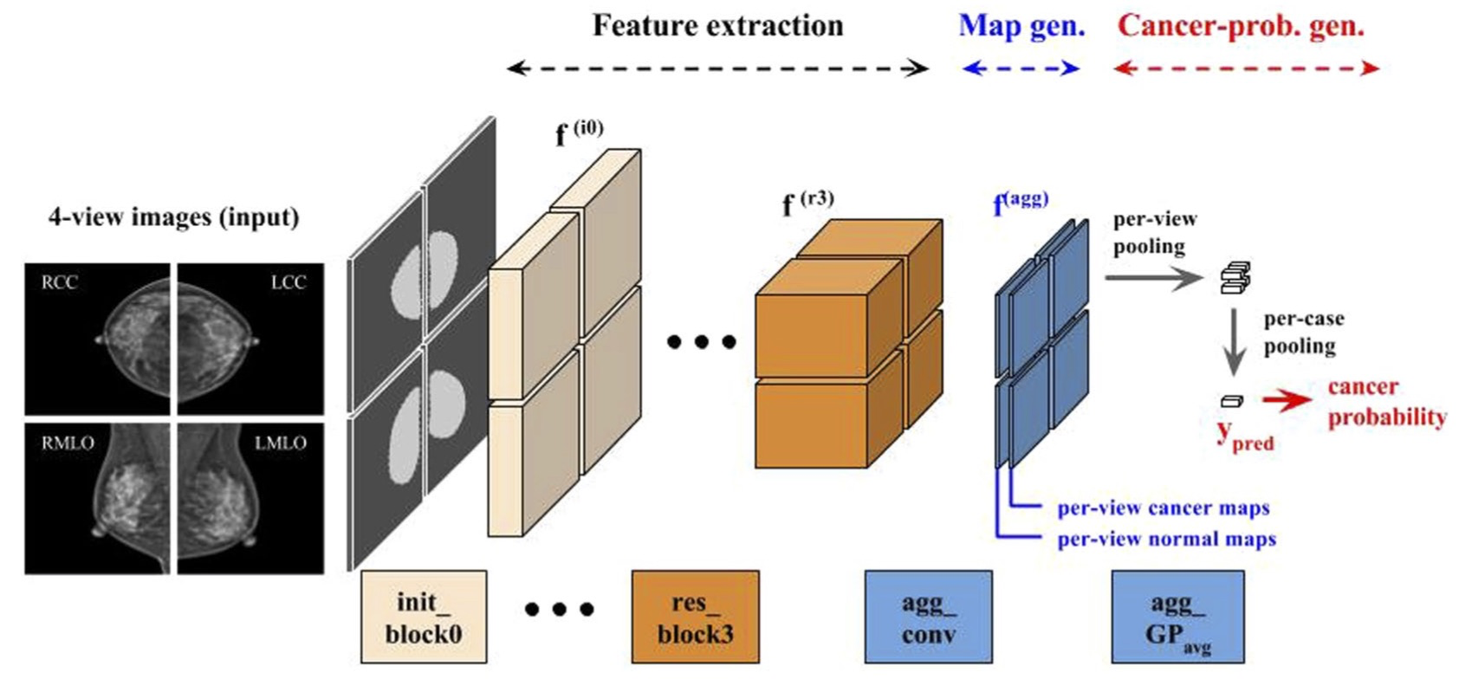
What can deep neural networks do? Medical diagnosis
Applying Data-driven Imaging Biomarker in Mammography for Breast Cancer Screening: Preliminary Study
Eun-Kyung Kim Nature, 2017.
AUC = 0.906.
Notes:
heart2019.pdf
Deep-learning cardiac motion analysis for human survival prediction
Ghalib A. Bello1,8, Timothy J. W. Dawes1,2,8, Jinming Duan1,3, Carlo Biffi1,3, Antonio de Marvao1,
Luke S. G. E. Howard4, J. Simon R. Gibbs2,4, Martin R. Wilkins5, Stuart A. Cook1,2,6,7, Daniel Rueckert3 and Declan P. O’Regan 1*
Motion analysis is used in computer vision to understand the behaviour of moving objects in sequences of images. Optimizing the interpretation of dynamic biological systems requires accurate and precise motion tracking as well as efficient representa- tions of high-dimensional motion trajectories so that these can be used for prediction tasks. Here we use image sequences of the heart, acquired using cardiac magnetic resonance imaging, to create time-resolved three-dimensional segmentations using a fully convolutional network trained on anatomical shape priors. This dense motion model formed the input to a supervised denoising autoencoder (4Dsurvival), which is a hybrid network consisting of an autoencoder that learns a task-specific latent code representation trained on observed outcome data, yielding a latent representation optimized for survival prediction. To handle right-censored survival outcomes, our network used a Cox partial likelihood loss function. In a study of 302 patients, the predictive accuracy (quantified by Harrell’s C-index) was significantly higher (P = 0.0012) for our model C = 0.75 (95% CI: 0.70–0.79) than the human benchmark of C = 0.59 (95% CI: 0.53–0.65). This work demonstrates how a complex computer vision task using high-dimensional medical image data can efficiently predict human survival.

Slide 10
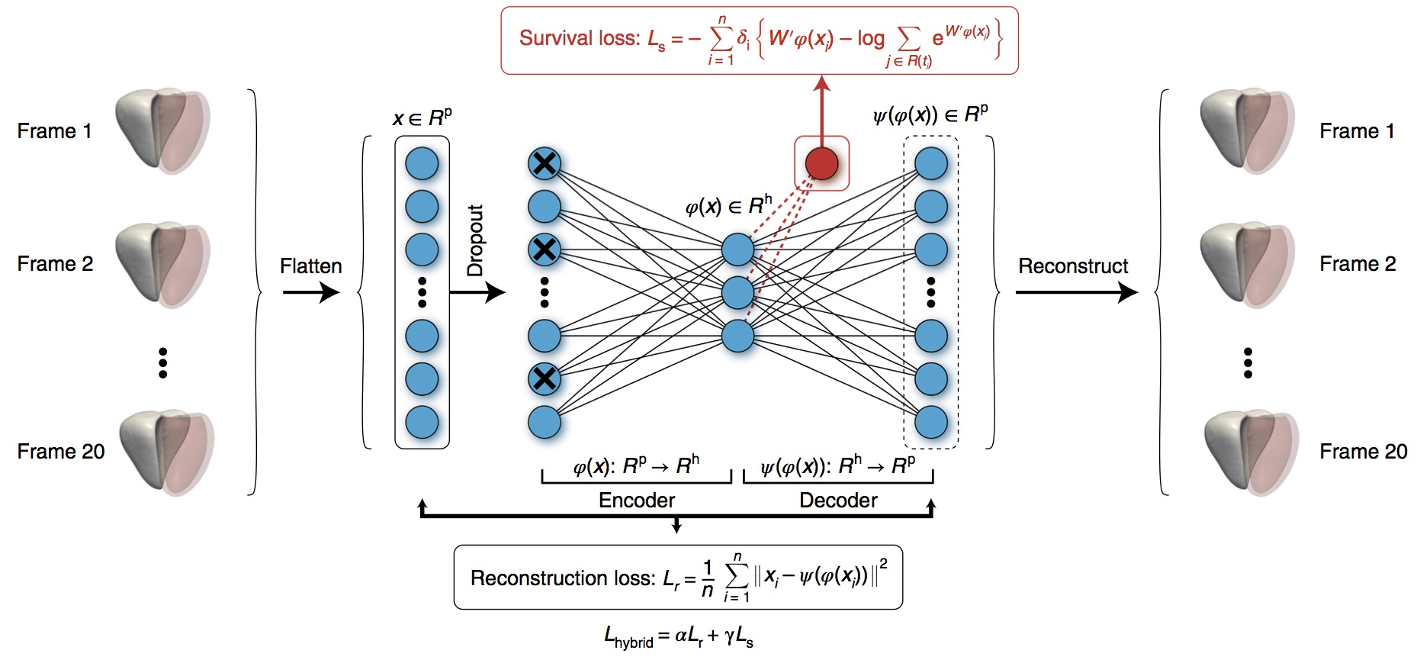
What can deep neural networks do? Medical diagnosis
Used a variational autoencoder to improve survival prediction based on motion of heart.
Ghalib et al 2019.
Notes:
heart2019.pdf
Deep-learning cardiac motion analysis for human survival prediction
Ghalib A. Bello1,8, Timothy J. W. Dawes1,2,8, Jinming Duan1,3, Carlo Biffi1,3, Antonio de Marvao1,
Luke S. G. E. Howard4, J. Simon R. Gibbs2,4, Martin R. Wilkins5, Stuart A. Cook1,2,6,7, Daniel Rueckert3 and Declan P. O’Regan 1*
Motion analysis is used in computer vision to understand the behaviour of moving objects in sequences of images. Optimizing the interpretation of dynamic biological systems requires accurate and precise motion tracking as well as efficient representa- tions of high-dimensional motion trajectories so that these can be used for prediction tasks. Here we use image sequences of the heart, acquired using cardiac magnetic resonance imaging, to create time-resolved three-dimensional segmentations using a fully convolutional network trained on anatomical shape priors. This dense motion model formed the input to a supervised denoising autoencoder (4Dsurvival), which is a hybrid network consisting of an autoencoder that learns a task-specific latent code representation trained on observed outcome data, yielding a latent representation optimized for survival prediction. To handle right-censored survival outcomes, our network used a Cox partial likelihood loss function. In a study of 302 patients, the predictive accuracy (quantified by Harrell’s C-index) was significantly higher (P = 0.0012) for our model C = 0.75 (95% CI: 0.70–0.79) than the human benchmark of C = 0.59 (95% CI: 0.53–0.65). This work demonstrates how a complex computer vision task using high-dimensional medical image data can efficiently predict human survival.

Slide 11


What can deep neural networks do?
Image Inpainting
Before
During
After
by NVIDIA
Notes:
https://www.nvidia.com/research/inpainting/

Slide 12
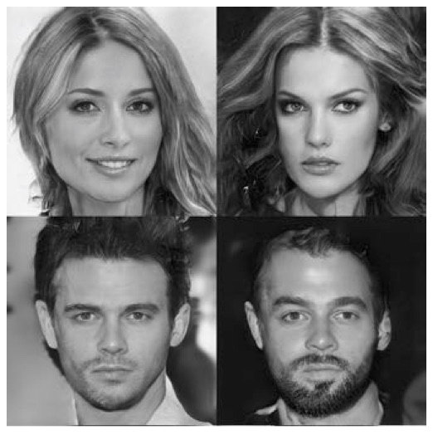
Synthetic
celebrity faces
Classified as
gibbon
adversarial
noise
Karras, 2018

Slide 13

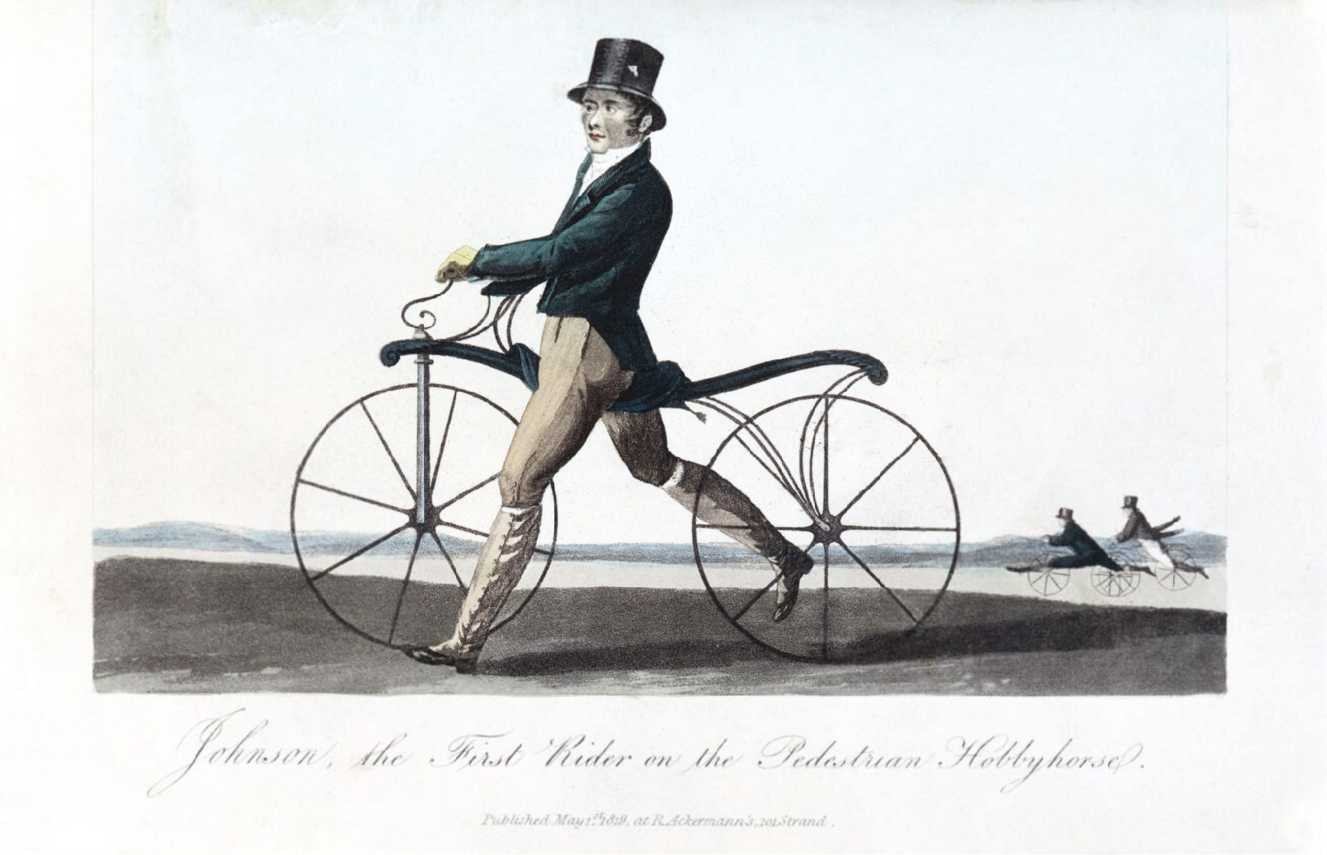
What can deep neural networks do? Cycling
View from above of cycle tracks. Randlov et al 1998

Slide 14
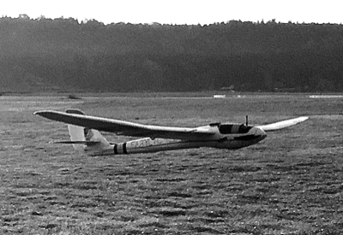
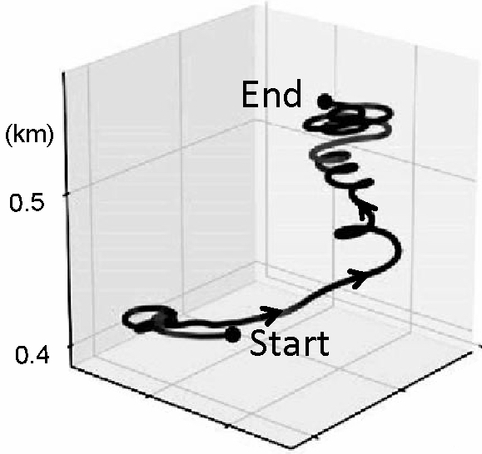
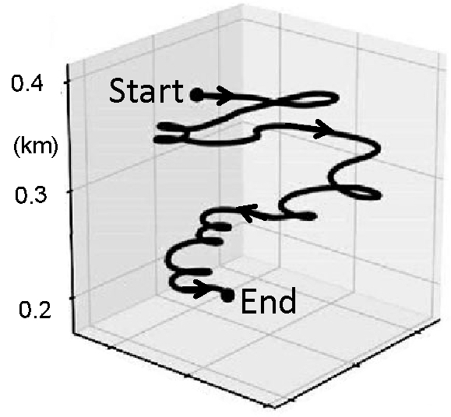
What can deep neural networks do? Flying
After learning
Before learning
Reddy et al 2016/18

Slide 15
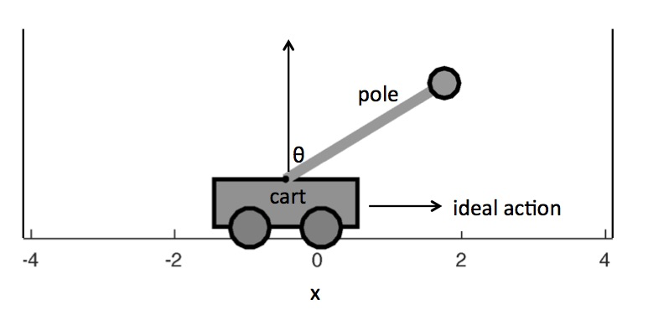
What can deep neural networks do? Balancing a pole
Sutton and Barto 1998-present

Slide 16
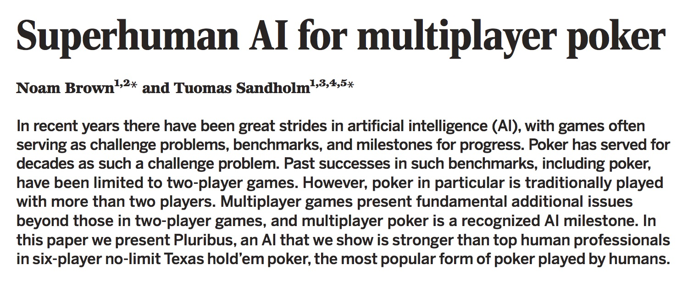
What can deep neural networks do?
Science, August 2019.
Notes:
heart2019.pdf
Deep-learning cardiac motion analysis for human survival prediction
Ghalib A. Bello1,8, Timothy J. W. Dawes1,2,8, Jinming Duan1,3, Carlo Biffi1,3, Antonio de Marvao1,
Luke S. G. E. Howard4, J. Simon R. Gibbs2,4, Martin R. Wilkins5, Stuart A. Cook1,2,6,7, Daniel Rueckert3 and Declan P. O’Regan 1*
Motion analysis is used in computer vision to understand the behaviour of moving objects in sequences of images. Optimizing the interpretation of dynamic biological systems requires accurate and precise motion tracking as well as efficient representa- tions of high-dimensional motion trajectories so that these can be used for prediction tasks. Here we use image sequences of the heart, acquired using cardiac magnetic resonance imaging, to create time-resolved three-dimensional segmentations using a fully convolutional network trained on anatomical shape priors. This dense motion model formed the input to a supervised denoising autoencoder (4Dsurvival), which is a hybrid network consisting of an autoencoder that learns a task-specific latent code representation trained on observed outcome data, yielding a latent representation optimized for survival prediction. To handle right-censored survival outcomes, our network used a Cox partial likelihood loss function. In a study of 302 patients, the predictive accuracy (quantified by Harrell’s C-index) was significantly higher (P = 0.0012) for our model C = 0.75 (95% CI: 0.70–0.79) than the human benchmark of C = 0.59 (95% CI: 0.53–0.65). This work demonstrates how a complex computer vision task using high-dimensional medical image data can efficiently predict human survival.

Slide 17
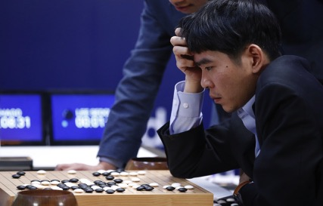
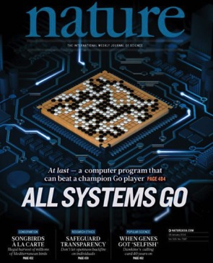
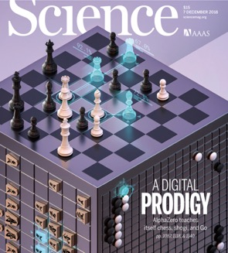
What can deep neural networks do? Go and Chess
2016: AlphaGo defeated Go grandmaster Lee Sedol.
2017: AlphaGo Zero beat AlphaGo.
2018: Alpha for chess, shogi (Japanese chess), and Go, beating a world-champion program in each case.
Notes:
2018 was alpha zero???

Slide 18
A neural network for car insurance
Input
variables
Output
variables
Age
Sex
Probability
of accident
Income
Cost
Experience
Probability
of fatality
Convictions

Slide 19
AI Before Artificial Neural Networks

Slide 20
History of AI

Slide 21
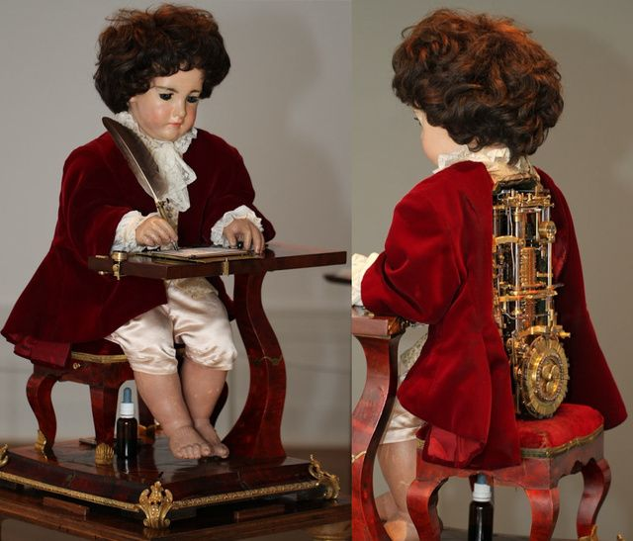
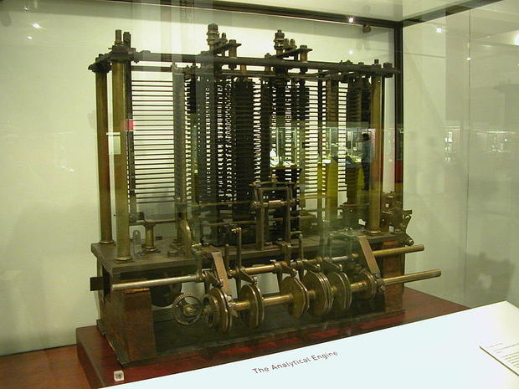
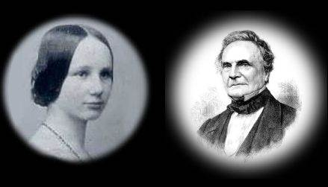
AI Before Artificial Neural Networks (1/2)
Pierre Jaquet-Droz,
The Writer, 1770
Ada Lovelace and Charles Babbage's Analytical Engine, 1842

Slide 22
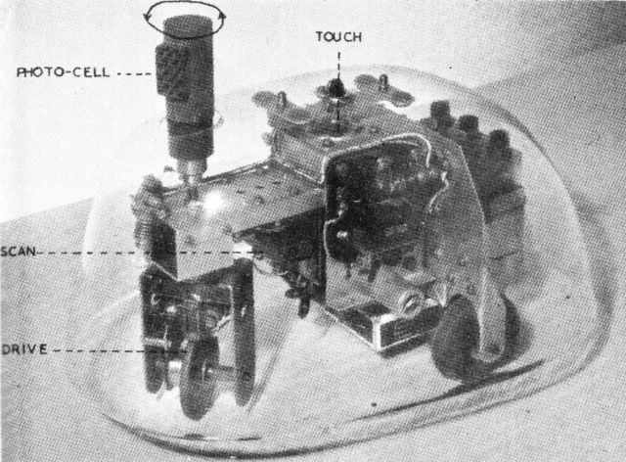
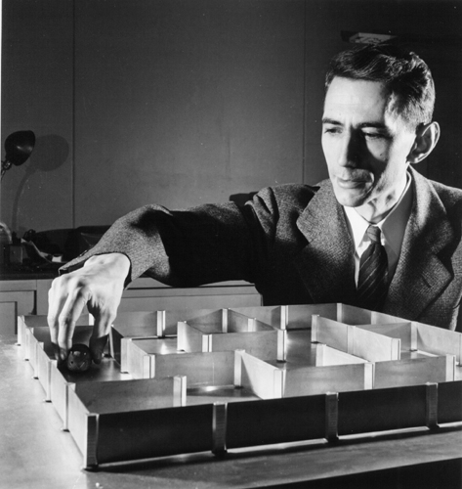
AI Before Artificial Neural Networks (2/2)
Claude Shannon’s
Theseus Mouse, 1950
Gray Walter’s Turtle 1948

Slide 23
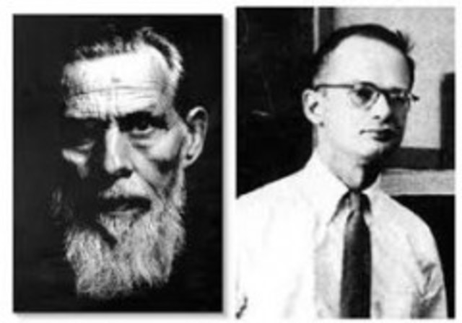
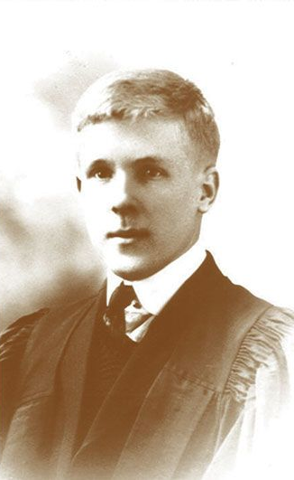
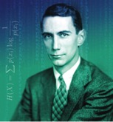
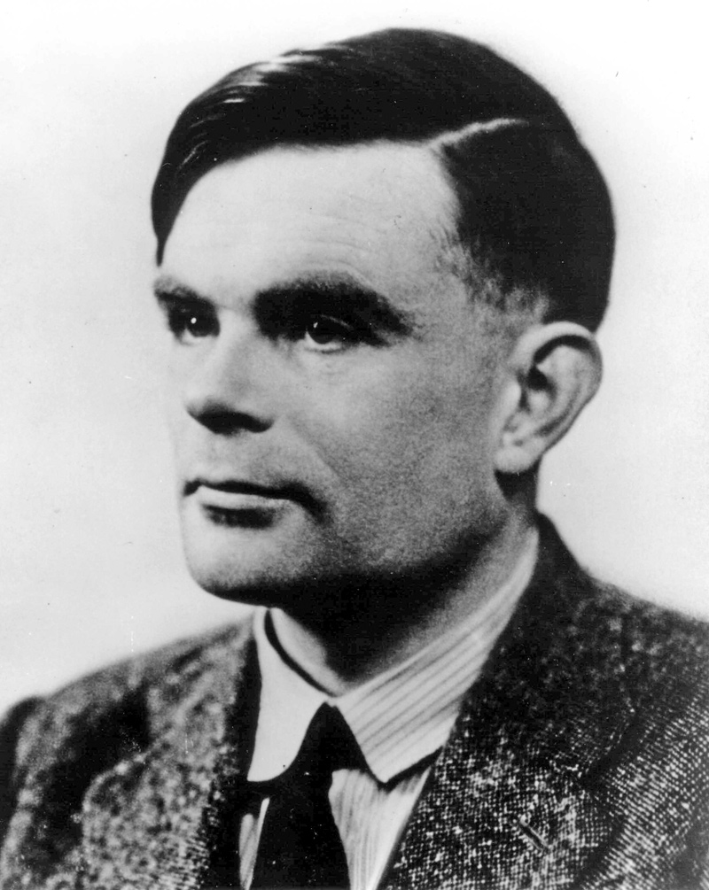
Key Developments: 1/4
1943: McCulloch and Pitts. "A logical
calculus of the ideas immanent in nervous activity”
1949: Donald Hebb.
“The Organization of Behavior”
1949: Claude Shannon.
"Programming a Computer for Playing Chess”.
1950: Alan Turing.
“Computing Machinery and Intelligence”.

Slide 24
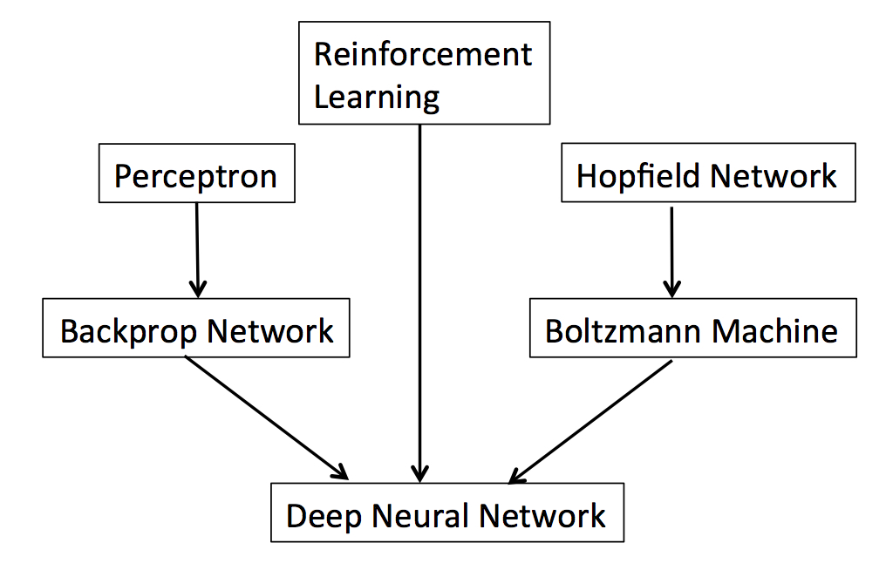
Neural Networks History: 1983-present
1983-present
1958
1982
1986
1984
2008-present

Slide 25
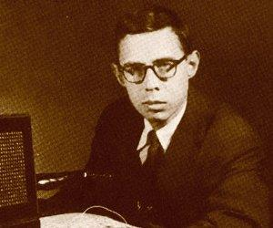
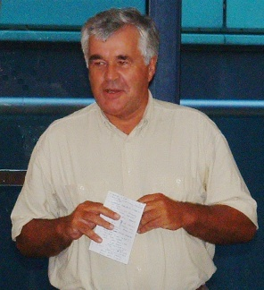
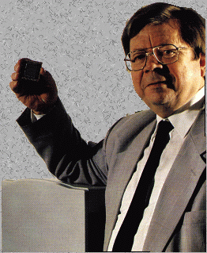

Key Developments: 2/4
1958: Frank Rosenblatt.
“The perceptron: A probabilistic model for information storage and organization in the brain.”
1970: Longuet-Higgins, Willshaw, and Buneman.
“Theories of associative recall”.
1972: T Kohonen.
“Correlation Matrix Memories”.
1982: John Hopfield.
“Neural networks and physical systems with emergent collective computational abilities”.
Notes:
1968: Longuet-Higgins, HC. “The non-local storage of temporal information”
1981: Geoffrey Hinton, “A parallel computation that assigns canonical object-based frames of reference”.

Slide 26
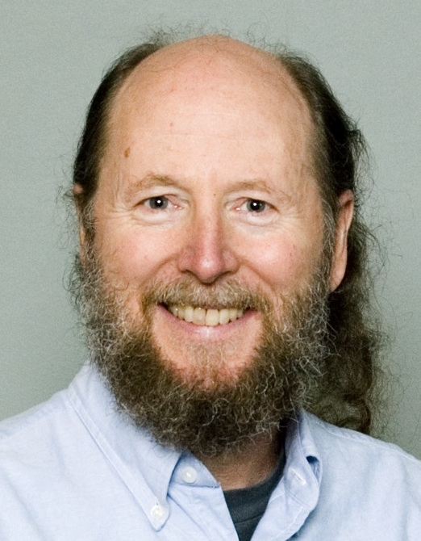
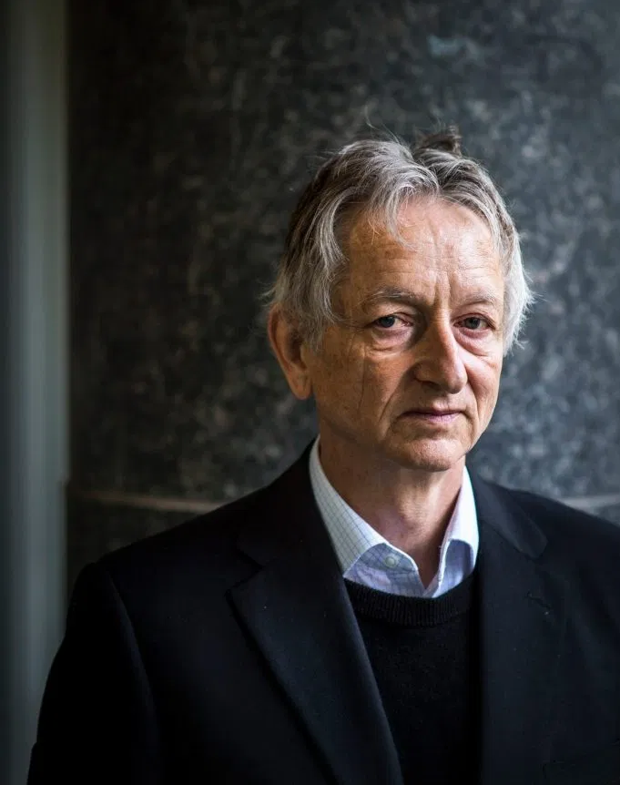

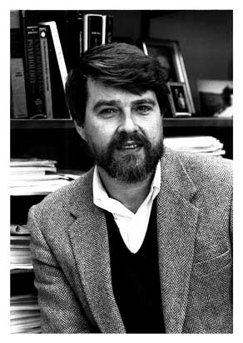
Key Developments: 3/4
1983: Barto, Sutton and Anderson.
“Neuronlike adaptive elements that can solve difficult learning control problems”.
1984: Hinton, Sejnowski and Ackley.
“Boltzmann machines: Constraint satisfaction networks that learn”.
1986: Rumelhart, Hinton and Williams.
“Learning representations by back-propagating errors”.
Notes:
1968: Longuet-Higgins, HC. “The non-local storage of temporal information”

Slide 27

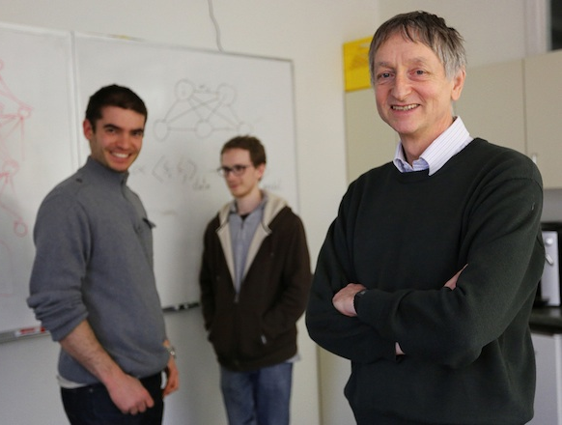
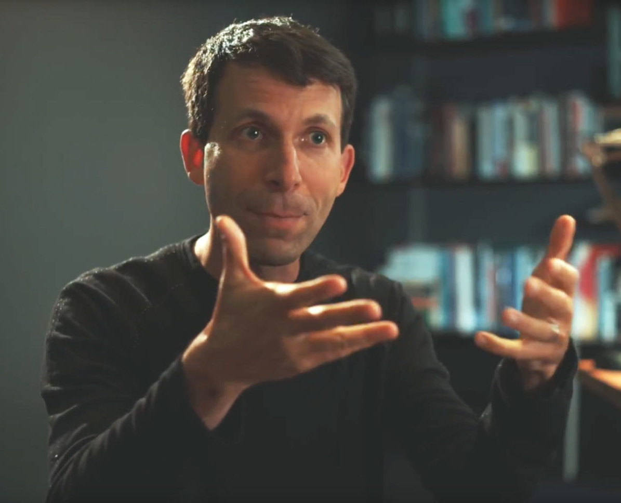
Key Developments: 4/4
1989: LeCun, Boser, Denker, Henderson, Hubbard, and Jackel.
“Backpropagation applied to handwritten ZIP code recognition”.
1995: G Tesauro. (backgammon)
“Temporal difference learning and TD-Gammon”.
2012: Krizhevsky, Sutskever and Hinton. (AlexNet)
“Imagenet classification with deep convolutional neural networks”.
2016: AlphaGo
“Mastering the game of Go with Deep Neural Networks & Tree Search”, Silver, Huang, et al. Nature 2016
defeated Go grandmaster Lee Sedol. (see below)
Notes:
1968: Longuet-Higgins, HC. “The non-local storage of temporal information”

Slide 28
What can deep neural networks NOT do?
Definition of AI:
“AI is what computers cannot do yet”

Slide 29
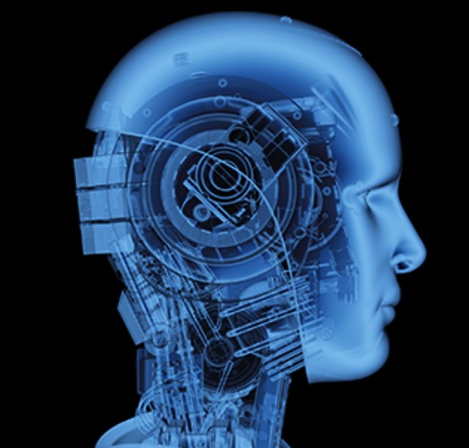
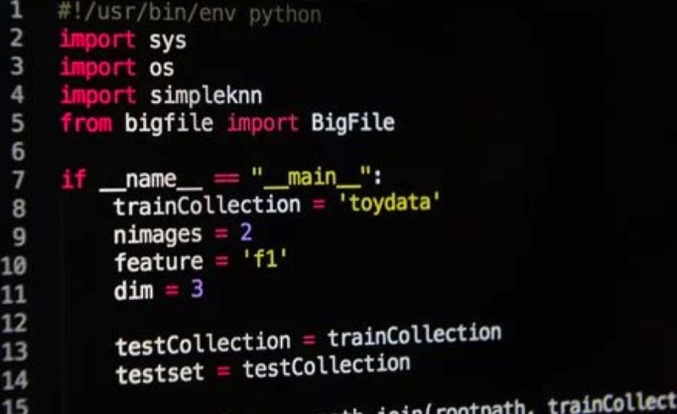
What can deep neural networks NOT do? Artificial Intelligence (yet)
AI in the press
AI in the computer

Slide 30
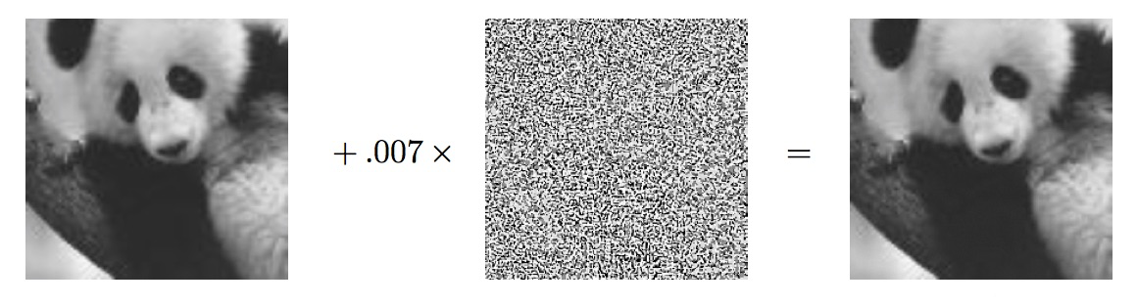
Classified as
gibbon
Classified as
panda
adversarial
noise

Slide 31
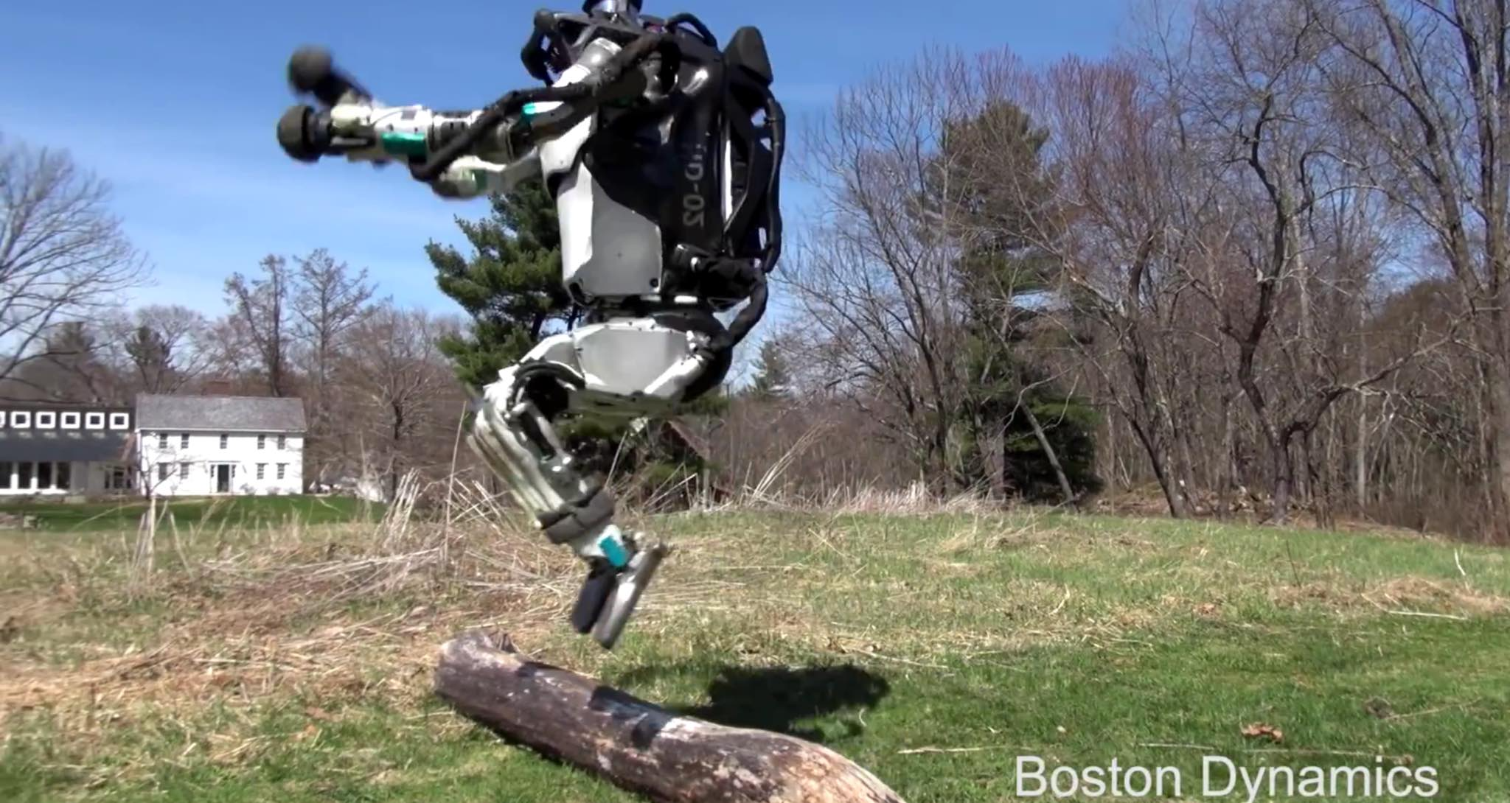
What can deep neural networks NOT do? Artificial Intelligence (yet)
washing up
walk on rough ground
fix a car
drive a car
put a t-shirt on
clear snow
build a shed
IKEA
take your pick
Boston dynamics robots do NOT use neural networks

Slide 32

In Conclusion: Can a machine think?
Before Orville and Wilbur Wright flew the first aeroplane in 1903, skeptics declared that a machine could never fly like a bird. Today, many of us are like those skeptics, doubting that a machine could ever achieve human levels of intelligence.
But birds and brains are physical devices, and that they both must obey the same laws of physics.
In other words, a bird is a flying machine that happens to be made of organic matter, and a brain is a computational machine that happens to be made of neurons.
It therefore seems obvious, and even inevitable, that a machine can fly even if it is not made of organic matter, and that a computational machine can be intelligent even if it is not made of neurons.
Q. Can a machine think?
A. Take a look in the mirror.

Slide 33
Recommended Resources
Geoffrey Hinton and Yann LeCun, The Turing Lecture 2019: https://www.youtube.com/watch?v=VsnQf7exv5I
Comment: An overview from key researchers.
Nielsen (2015), Neural Networks and Deep Learning is a free online book. http://neuralnetworksanddeeplearning.com/
Comment: A little dated, but still makes a fine starting point.
Stone (2019), Artificial Intelligence Engines: A Tutorial Introduction to Deep Learning.
Comment: !

Slide 34
Thank you

Slide 35
THE END

Slide 36
THE END

Slide 38
The Turing Day
The workshop will be mostly lectures followed by a lab session.
10:00-11:00 Introduction: Deep Learning and AI: What it is, what it can, and cannot do. JVS
11:00-12:00 Overview: From linear networks to convolutional networks. SJE
12:00-13:00 Lunch
13:00-14:00 Deep Learning using Gradient Descent: What it is, and how it can fail. Backprop and overfittng and vanishing gradients. JVS
14:00-15:00 Reinforcement Learning. LDC
15:15-17:00 Using Python for networks. Lab session with all three instructors.

Slide 39
What is a deep learning neural network?
weight
unit

Slide 40
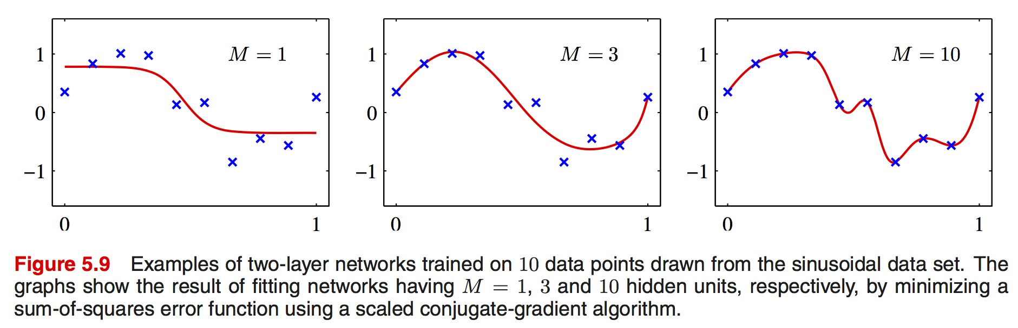
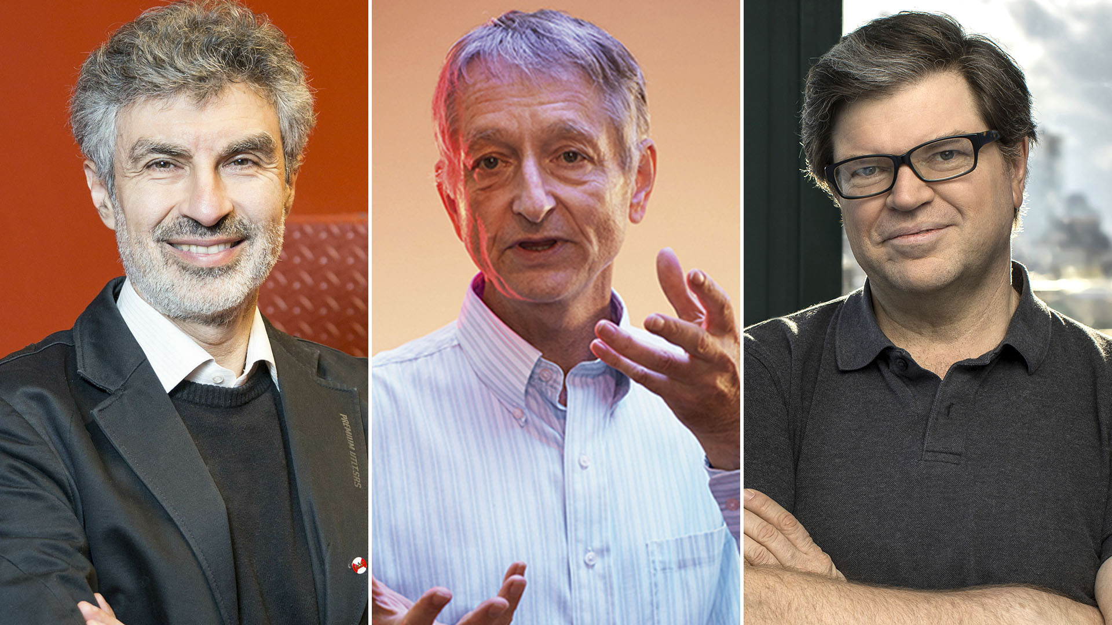
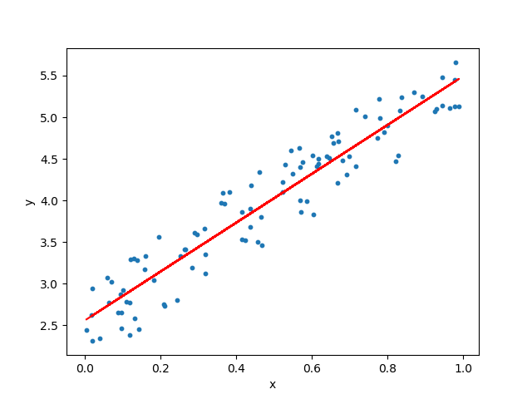
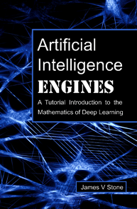
Spare pictures
Object recognition
Chess etc
Flying
Medical diagnosis

Slide 41
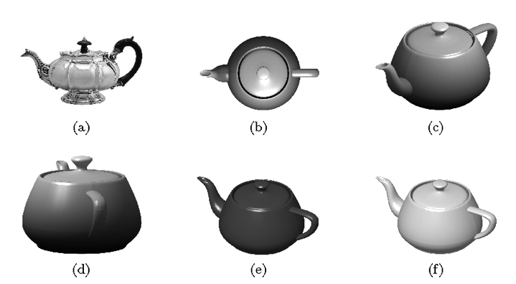
What can deep neural networks do? Why object recognition is hard
Basically, objects can appear at any size/orientation/colour.
Consider a square (black and white) image of 1,000 × 1,000 pixels.
If each pixel can adopt 256 grey-levels then the number of possible images is 256^{1,000,000} (atoms in the universe = 10⁸⁷).
Most of these 256^{1,000,000} possible images look like random noise, and only a tiny fraction depict anything approaching a natural scene — and only a fraction of those depict a teapot.
If a network is to discriminate between teapots and non-teapots then it implicitly must assign a probability to each of the 256^{1,000,000} possible images.

Slide 42

What can deep neural networks do?
Notes:
https://www.nvidia.com/research/inpainting/

